Slide 1
Java Server Page 09강 – 템플릿(Templates)
By. Lee Sera

Slide 2
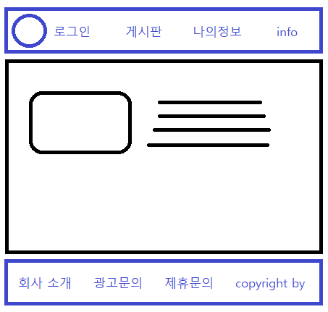
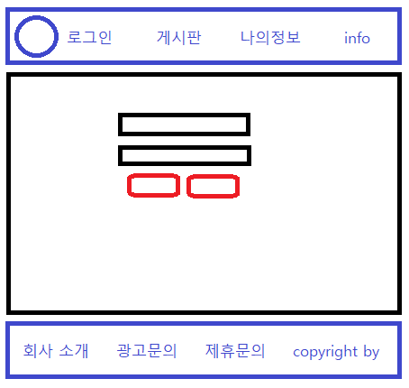
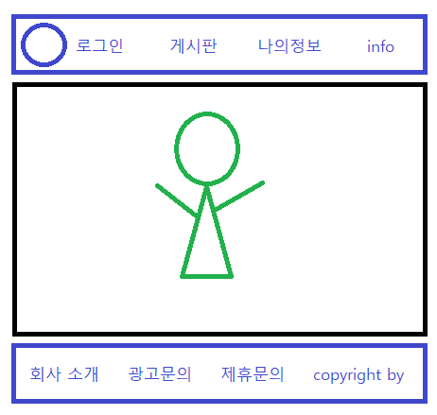
Lecture 09
템플릿
Copyright © Lee Sera

Slide 3
끝!
Copyright © Lee Sera

